Slide 1

welcome
​​
Pitch

Slide 2

Project TEAM
M.BHARATH - 20L31A05D5
M.JOSHITH -20L31A05E3
M.V.SUSHRIYA -20L31A05E6
P.PAWAN – 20L31A05H3
P.YASWANTH SAI – 20L31A05I3
About

Slide 3

Introduction
The present time is an area of internet. In the developed countries almost every system goes by using internet.
A person can fulfill his purpose without going outside.
Online system is being used in almost all sectors of our life such as education, marketing, transportation , transactions etc.
Several countries have started this process long before.

Slide 4

Website benefits
foreword
In our country , but in some places such as pizza hut , KFC, MYZ UNO etc have started this process.
But it has not started in most of the restaurants .
Majority of the people of our country are not much aware of this system.
Our main target is this all process should be more precise.
Simple and efficient to use​
Quick customer service assistance​
Free 90-day customer service phone number​

Slide 5

Problems
Market gap
Customers
Financials
Restaurants need new software solutions but are using old or outdated tools and services​
10% increase of POS efficiency prove that there’s a market for simpler POS tools​
New restaurant tools increased profits by $20 million in 2019 ​
Costs
Usability
Loss of potential income by not offering new tools for restaurant workers ​
Service industry professionals want something that’s easy to adopt and simple to use for their restaurant​

Slide 6
Solution
Cost savings
Solution
Close the gap
Target audience
Easy to use
A simple product that gives restaurants the information they need in order to make informed staffing decisions ​
Our product makes restaurant management easier.​
Restaurant managers
Reduce costs for client by helping restaurants gauge their inventory and reservations ​by making online

Slide 7

Product overview
Unique
First to market
Only product specifically dedicated to the restaurant industry.
First beautifully designed product that's both stylish and functional​.
Tested
Authentic
Conducted testing with restaurants in the area.
Designed with the help and input of restaurant and service workers in the field ​.

Slide 8


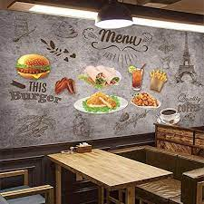
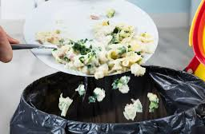
objectives
How we’ll scale in the future​
To increase efficiency and improve services provided to the customers .​
To be able to stand out from competitors in the food service industry.
To reduce restaurant’s food wastage

Slide 9

Business model
research​
We based our research on market trends and data from over 1,000 restaurants​
abstract
We believe managers need new industry tools and mandatorily websites to help run their restaurants​
Business
design
Minimalist design and easy to use ​

Slide 10
2-Year action plan
Supply volunteers​
Run focus groups​
Gather feedback​
2021
Jan
Feb
Mar
Apr
May
Jun
Jul
Aug
Sep
Oct
Nov
Dec
Test with restaurants​
Regional launch​
Deliver to consumers​
2022
Jan
Feb
Mar
Apr
May
Jun
Jul
Aug
Sep
Oct
Nov
Dec

Slide 11

Summary
Sum
At Resto, we believe in giving 110%. By improving the tools of restaurant management, we help businesses streamline their point-of-sale experience.
We thrive because of our market knowledge and a great team behind our product.

Slide 12

Thank You
​
Than

